Slide 1

Welcome to the CFI84 PTSA Meeting!
We’re glad you’re here!
We will begin promptly at 6:05pm.
If you’re joining on Microsoft Teams, please ensure your name is displayed. All attendees will be muted.
If you’re in-person, please introduce yourself to someone you do not know.
If you are unfamiliar with our Essential Agreements & Procedural Norms, please review them now via the link in the chat.
Notes:
Meeting called to order at 6:05pm.
In-Person:
Virtual: Alex Hamm

Slide 2
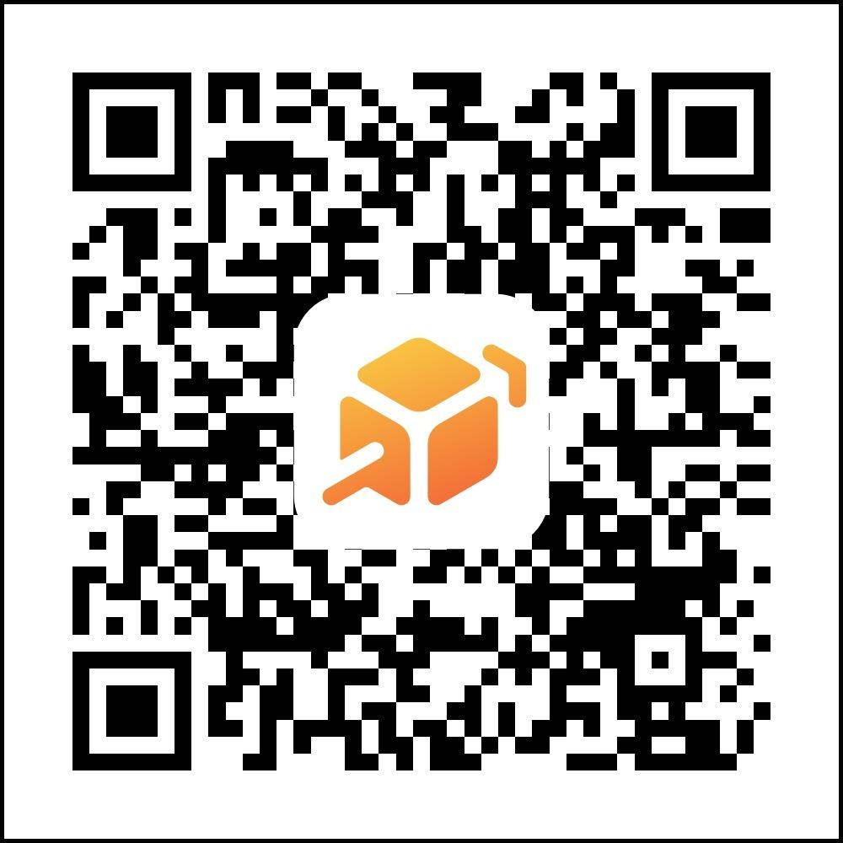
To be a voting PTSA member, please pay your PTSA dues.
Scan to pay dues.

Slide 3
CFI84 PTSA Meeting Agenda
Welcome
Essential Agreements & Procedural Norms
December 2025 Minutes Approval
Treasurer Report & Nomination
Principal Miller’s Report
Committees & Coordinator Updates
Upcoming events & Volunteer opportunities
Motion to Adjourn

Slide 4
Essential Agreements & Procedural Norms
Your continued presence at this meeting affirms your commitment to adhere to these Agreements & Norms.
Essential Agreements Mapped To… | Procedural Norms
Transparency & Responsiveness: We want to be transparent in our norms and work, and responsive to all questions and comments. | Minutes will be taken in line with nonprofit norms and shared in a timely manner with the entire school community. An anonymous feedback survey will be offered after every meeting. Questions not answered in the meeting and placed in the Chat, or sent in the survey, will be responded to in a timely manner. Questions that address topics over which we have no decision-making power or control will be directed to the appropriate parties.
Trustworthiness: We want our meetings to be a safe space where everyone feels free to share. | Voting will be anonymous. We’ll use Microsoft Teams while virtual. Comments made by someone other than yourself may not be used outside this space. Comments and questions may only include your own voice.
Inclusivity: We want to be an organization that is designed with the inclusion of all people in mind. We shall do our best to break down all barriers to inclusion. | When presenting or sharing, speak as if your audience is completely new to the topic at hand. We have new parents and staff join our meetings all the time. Committees will remain open to new members.
Respect: We want to be respectful of ideas that are shared and the people who share them. Disagreement is okay, but we can disagree while adhering to the agreements and norms we have established as a group. | Name-calling, bullying and harassment will not be tolerated at Board or Committee meetings. A reminder to our commitment to adhere to these norms will be given. If the behavior continues, the offending individual may be muted and/or removed from the current and future meetings.
Commitment to the Work: We want our Board and Committee meetings to be efficient and effective. | We will reaffirm our adherence to these Agreements & Norms at the beginning of every meeting. We will begin and end on time. Those who join late will be admitted and private messaged the Agreements & Norms. If you choose to stay, you are agreeing to adhere to them. The CFI84 PTSA, and its committees/coordinators, have specific scopes of work. All officers, chairs, coordinators, members and volunteers who choose to engage in the work agree to support its implementation. Anyone working against the work may be removed or barred from meetings, emails, etc.

Slide 5
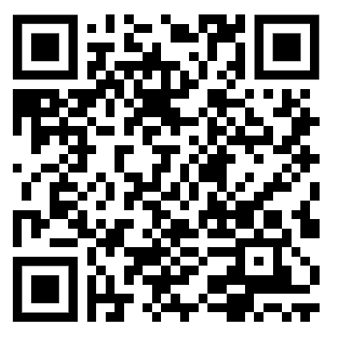
February 23, 2026 Minutes Approval
Discussion: (to review go to https://www.cfi84ptsa.org/)
Motion To Approve:
  Kindly please say your name allowed for the minutes record, virtual attendees please vote via the chat and linked forms*
  1st: Jes Daszkiewicz
  2nd: Paige Cardamon
  Vote: 6 Yes 0 No
***Remember that only PTSA members may vote.***
Notes:
Yes: 6/6
No: 0/0

Slide 6
Treasurer Report
Beginning Balance $64,107
+Bridge the Gap 40,178
+Parent Parties and UPP 32,261
+Silent Auction 19,004
-Bridge the Gap (40,178)
-PTSA Match (30,000)
Outstanding Checks ( 1,900)
Net Checking Acct Balance $ 83,472
*All numbers approximate. Some additional BTG and UPP funds still being reconciled
Notes:
Blair Bellamy
We started with $64,000.
The $40,000 from Bridge the Gap and the other big funds are the Ultimate Parent Party and silent action, which came in around $50,000 and is what we expected.
The $30,000 PTSA match is the match that we will provide.
The outstanding checks are for normal course of business.
We expect that we will have another $5,000-$6,000 of expenses for the year

Slide 7
Treasurer Report
Motion to Approve
Discussion:
Motion To Approve:
  1st: Stephanie Butcher
  2nd: Ashley Reiff
  Vote: 6 Yes 0 No
***Remember that only PTSA members may vote.***
Notes:
Yes: 6/6
No: 0/0

Slide 8
Treasurer Nomination:
Nomination for Next Year’s Treasurer: Stephanie Butcher
  Mother of Lyra (9), Hattie (7) and Nolan (5), Wife of Garrett
  We are a family that loves sports, board games and the outdoors
  My Husband and I were collegiate athletes here in Indy and decided to stick around/do life here and have loved it!
  Next school year, all three of our munchkins get to be at 84 together and we are really looking forward to it!

Slide 9
Treasurer 2026-2027 Vote:
Motion to Approve
Discussion:
Motion To Approve:
  1st: Lindsay Dodyk
  2nd: Jes Daszkiewicz
  Vote: 7 Yes 0 No
***Remember that only PTSA members may vote.***
Notes:
Yes: 7/7
No: 0/0

Slide 10
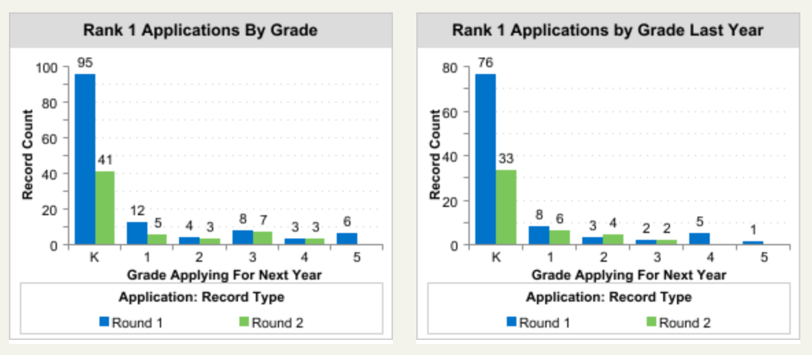
Principal Report
Lottery Applications
Notes:
Kathleen Miller
This is the lottery update from last Tuesday.
We are up a good bit from last year.
All other grade levels are all over depending on what is going on.
Kindergarten numbers show there is a lot of interest in coming to CFI 84.
We have had a lot of parent tours to the point of having to split them up.
We have also added several tour dates.
Round 1 results went out.
This is all very encouraging given all the changes going around.

Slide 11
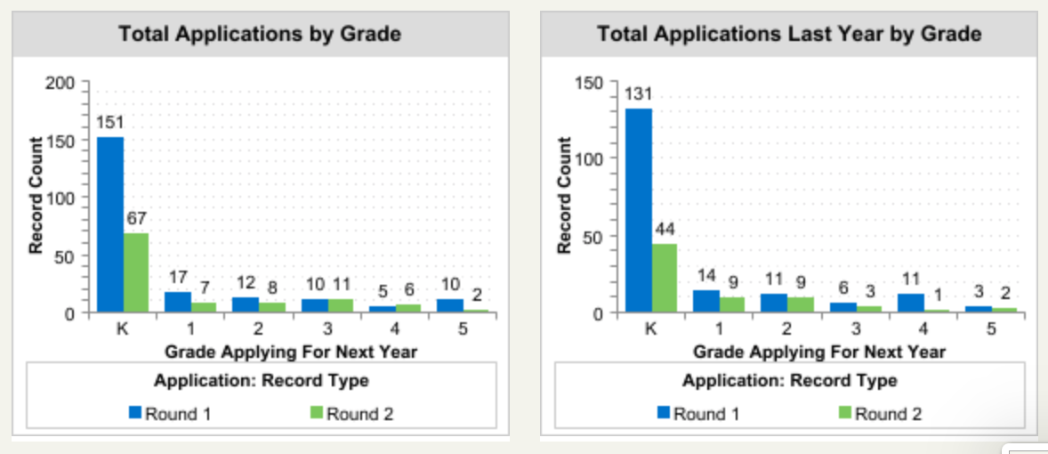
Principal Report
Notes:
Kathleen Miller
For staffing, we are finalizing a few things and will have an update by Friday hopefully.
There are very few changes.
We are excited about opportunities that we’ve come across.
We met with a new teacher today.
We will not stop interviewing because you never know what can happen - whether someone moves or things like that.

Slide 12
CFI 84 Awarded the Arts for Learning Artists Building Community (ABC) Fellowship
$200,000 Artist Building Community (ABC) Fellowship from Arts for Learning!
Will supplement our already strong visual arts and music programming with an opportunity to highlight “tactile, physical, and process-based art forms that are often marginalized or simplified in elementary setting”
Our vision is to partner with a Teaching Artist whose practice elevates making, material exploration, and cultural tradition. These experiences will be woven into IB units of inquiry at every grade level over the next three years.
We look forward to embarking on this process and will share updates and opportunities for engagement with our school community as it progresses!
Notes:
Meg Horn and Kathleen Miller
Meg Horn and Rachel Green Sharp met with the artist.
We will share more broadly once we have an execution plan and are exploring several units with the artist.
We received our number one choice, and her name is Nazarene Kahn.
She went to an IB school abroad and does a lot with woodworking and woodburning.
This is not a supplemental art program here!
This is a separate inquiry base, and she will be working with the art teacher and other teachers here.
She is going to have a vision for each of the 6 IB units, and we want to make it sustainable for beyond the three year program.

Slide 13
Bridge the Gap Campaign
Donated to the Bridge the Gap Campaign: $42,778
Full match from PTSA: $30,000
Total Earned Via Campagin: $72,778!
Thanks to all who donated and shared to spread the word!
Notes:
We did meet our goals
$42,000 was donated, and the PTSA was able to do the full match, which is $30,000.
This amount does not include the $15,000 that we voted on and approved at a previous meeting.
This will provide stability for next year.

Slide 14
Committees & Coordinators
Committees | 2025-2026
Gardening & Outdoor Spaces | Paige Cardamon, Jen Thiebert
Hospitality & Teacher Appreciation | Lindsay Shaw & Ashley Reiff
Fundraising | Lindsay Dodyk, Stephanie Kime, Jes Daszkiewicz, Lisa Noe, Stefanie Collier & Kaela Cusack (OPENINGS FALL 2026- Silent Auction, Parent Paries, Raffle )
Book Fair | Punam Lively & Julie Gulden
New Family & Community Support | Abigail Black & Chelsea Carpenter
Coordinators | 2025-2026
Volunteer Coordinator | Valerie Brod
Movie Night | Julie Gulden, Melissa Warth, Tanya Couvillion & Laura Ruhl
Chit Chat Coordinator | Melissa Warth
Dine to Donate | Jen Colson- Estes
Grade Parent Coordinator | Katherine Castro- Jen Thiebert committed taking on for Fall 2026
Spirit Wear | Tanya Couvillion
Parent Copy & Coffee | Jes Daszkiewicz - Emily Knusden commited to taking on for Fall 2026
Notes:
The big need is for fundraising. If you know anyone who may be a good fit, please let us know. It can be multiple people as well.

Slide 15

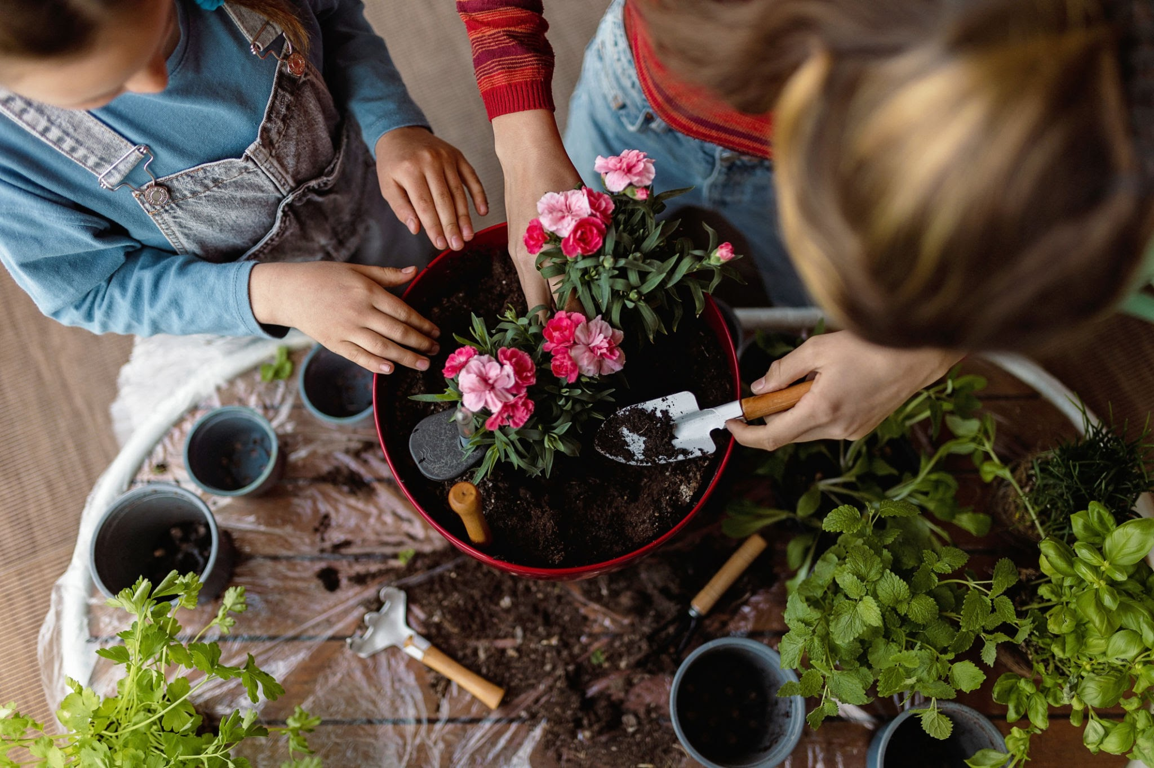
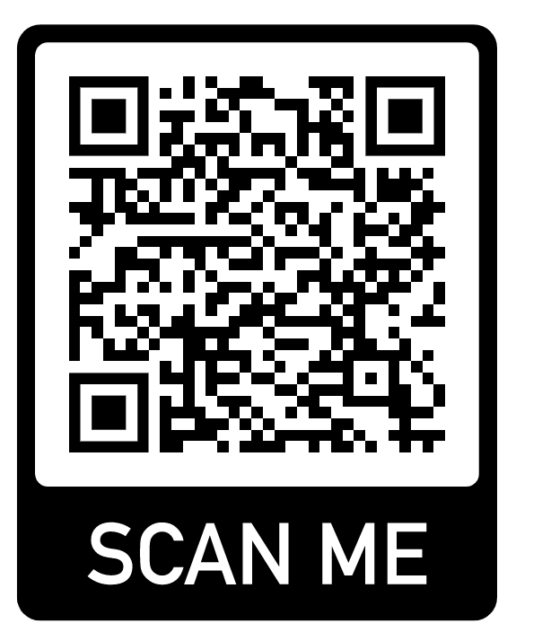
Gardening Day - May 1st
Rock painting
Donation by Stone Center - Mack Oldham to pick up
Extra egg cartons- Paige
Kindergarten flowers
Donation by Sullivan Hardware – Paige to pick up 4/30
  Pre-drill/dig holes – Jen T. /Paige
  Fencing/barrier at door 3- Jen T.
Re-assign grade level areas
New signage ☺
VOLUNTEER
Notes:
Paige Cardamon
Rock painting is under control.
Stone Center is donating rocks, and Sullivan’s is donating the kindergarten flowers.
We also received new signage for all grade levels as well as a fence by Door 3 to protect the flowers once kindergarten plants them.

Slide 16
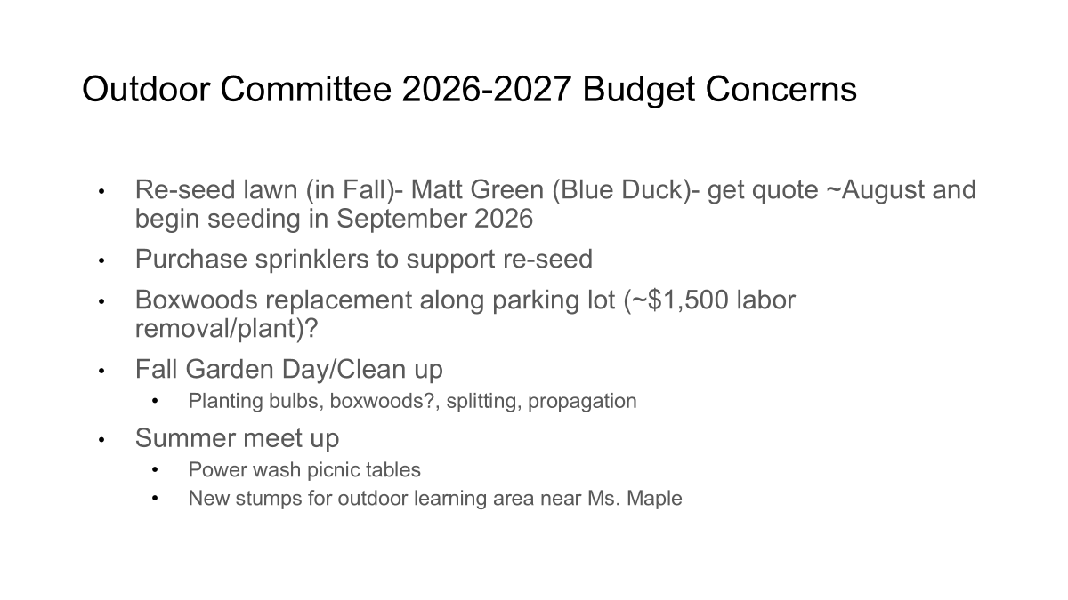
Notes:
Paige Cardamon
Meeting with Blue Duck for reseeding the grass, and we will also need to purchase a few sprinklers to support that.
The boxwoods by the parking lot are dead, and we received a quote for $1,500 for labor and not including plants.
Reach out if you know someone who can give us a quote on this.
We are planning on meeting in the summer to power wash picnic tables and find new stumps.

Slide 17
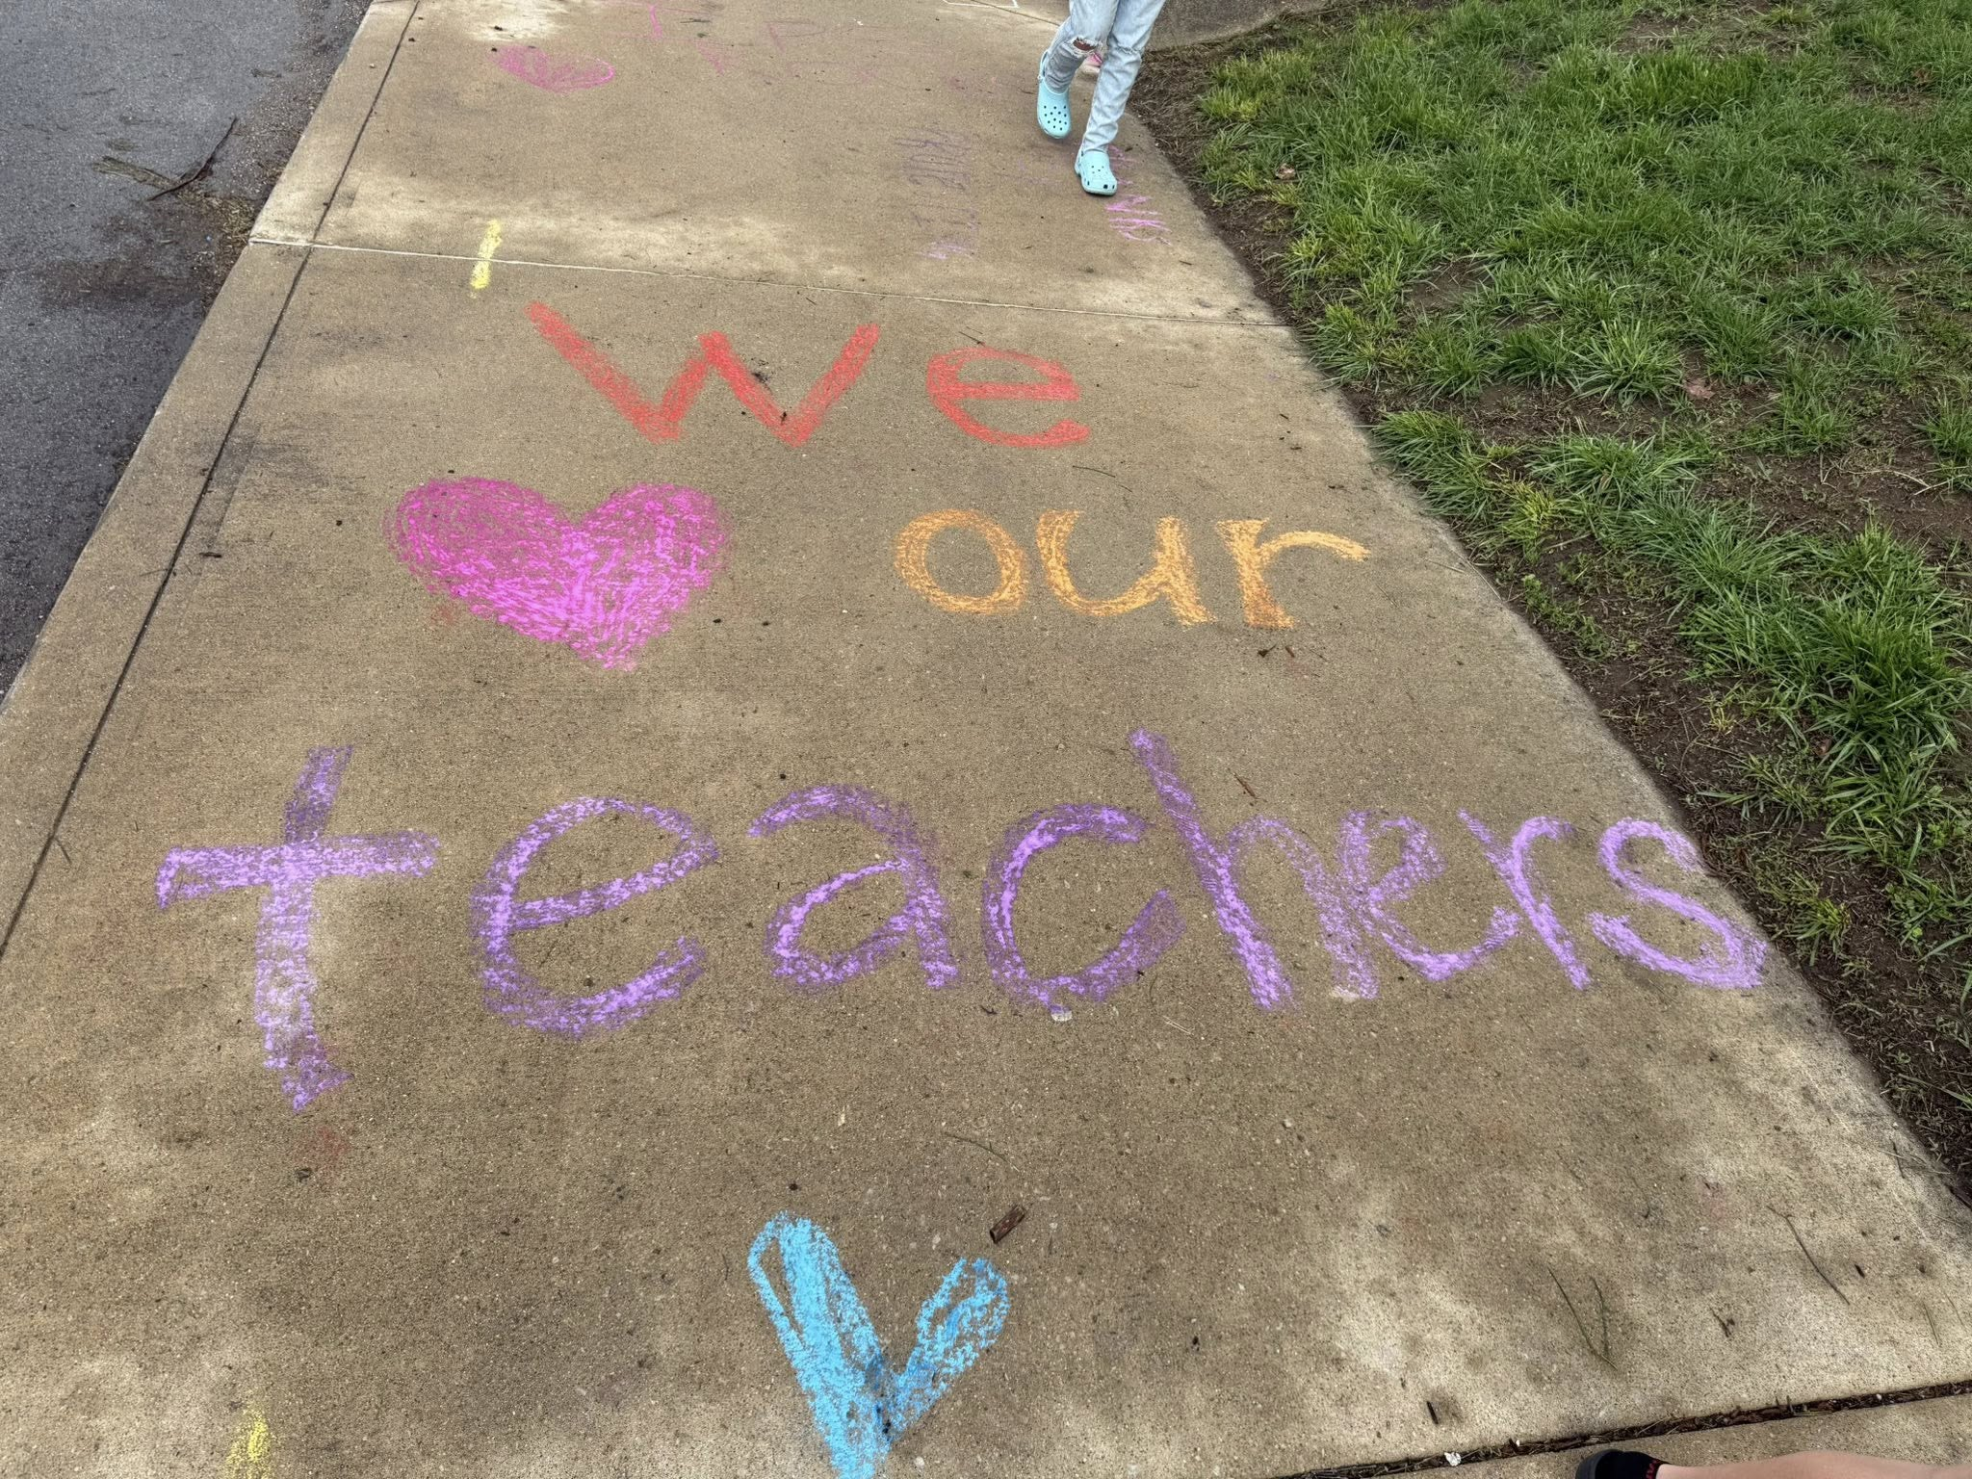
Teacher Appreciation Week (May 4th- 8th)
Friday May 1st: DECORATIONS:
1 Volunteer: Decoration LEADER-
  obtain/make/donate decorations/signs banners to decorate for Teacher Appreciation Week (sign up by 4/24- signs/doractions needed by Friday May 1st at 4 pm)
4 Volunteers: Friday May 1st 4pm/dismissal- 5 pm (decorate for Teacher Apprecation Week). Meet in the front office
Sunday, May 3rd: CHALK THE WALK:
1 Volunteer: Chalk the Walk LEADER-
  Chalk the Walk is scheduled Sunday May 3rd (primarily teacher parking lot area/front entrance). Leader(s) will coordinate volunteers
15 Volunteers: Sunday May 3rd- 1- 3pm
  Decorate the teacher parking lot/front entrance with chalk
Notes:
Lindsay Shaw
For Friday, we are going to decorate inside the school and need volunteers for that, especially a leader for decorations.
On Sunday, we are going to chalk the walk and focus on the parking lot since a lot of teachers do not come in the front of the school.

Slide 18
Teacher Appreciation Week (May 4th- 8th)
Monday, May 4th: FLOWER DUTY
2 Volunteers: 10:30a-11a Meet in Parent Center
  Help pot plants / flowers for teacher gifts + support student helpers
Tuesday, May 5th: SNACK CART
1 Volunteer: Snack Cart LEADER
  Coordinate snack cart donations, orders and volunteers
2 Volunteers: 12p-1p Meet in Parent Center
  Fill teacher /staff snack orders
2 Volunteers: 230p-4p
  Deliver Snack orders to teachers / staff
Wednesday, May 6th: HYDRATION STATION
2 Volunteers: 12p-1p Meet in Parent Center
  Refill hydration station in the parent center (fruit infused waters)
VOLUNTEER
Notes:
Lindsay Shaw
On Monday, we need volunteers to pot plants for teachers.
On Tuesday, we are going to give them options on what to worder for lunch, and we will bring them what they order.
On Wednesday, we are going to have infused waters and need volunteers to help Ms. Bloss in the Parent Center.
PTSA will also sponsor a meal and Melissa Warth offered to sponsor breakfast for Monday.
A lot of people have donated to the wish list, and almost everything is purchased.

Slide 19
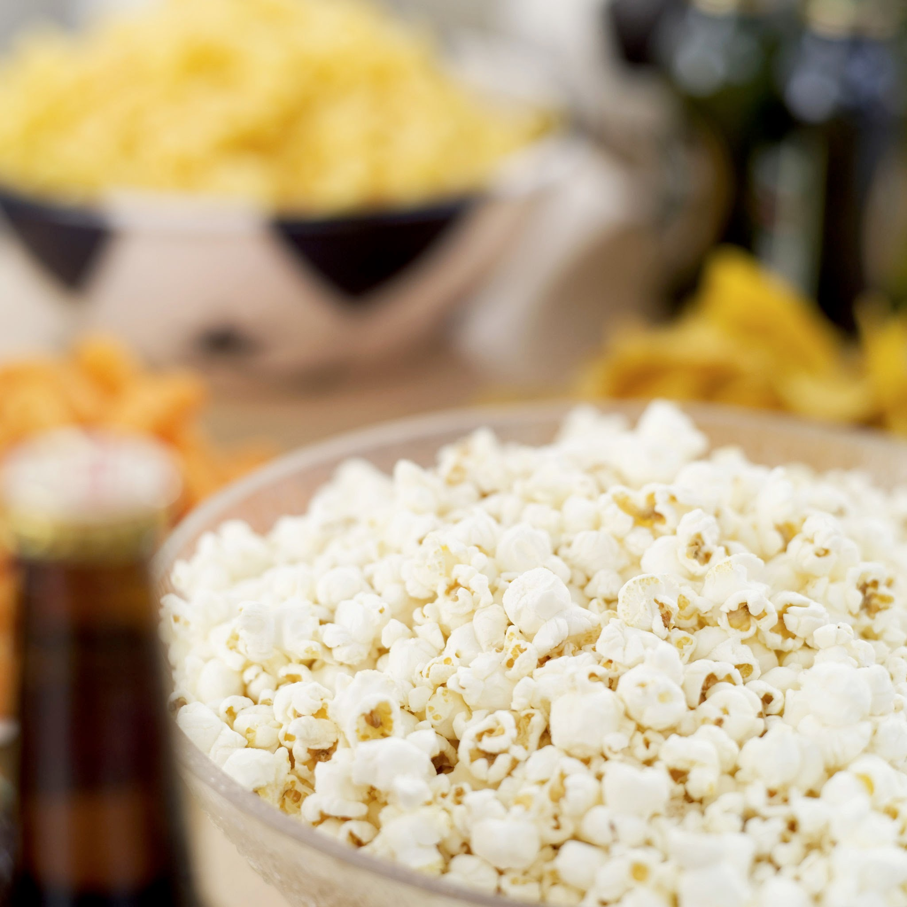
Teacher Appreciation Week (May 4th- 8th)
Friday, May 8th: POPCORN BAR
1 Volunteer: POPCORN BAR LEADER
  Coordinate popcorn bar and volunteers
2 Volunteers: 11a-1230p Meet in Parent Center
  Help set up / make popcorn for teachers / staff
2 Volunteers: 1230p-2p Meet in Parent Center
  Help make popcorn for teachers / staff and clean up
Check Toddle / signup genius to get involved!
We’re looking for donations (AMAZON WISHLIST) and volunteers!

Slide 20

Fundraising/Ultimate Party 2026
Event: $23,294
    193 tickets sold (216 attended)
    $1350 in sponsorships
    In Kind donations $2,750
    Event expenses $9300
Silent auction: $19,004
Parent Parties $17,980
Total raised $60,278
$8,100 to IPS Equity fund
Net to CFI84 $42,878
Bridge the Gap
$42,778
plus
$30,000 PTSA match
$72,778
Notes:
Lindsay Dodyk
The event raised $23,294.
The 193 tickets does not include the 14 teacher sponsored tickets.
More people just bought a ticket this year instead of sponsoring - we typically have a lot of people buy the $300 one.
The event expenses was more per person with a drink cost.
We need to expand efforts in food to have variety and not continue to ask the same people.
The silent auction raised $19,004.
Jes took on the burden for silent auction.
We need to have two people to agree to do the silent auction - if we don’t, we need to change the goal
JV: can we have something at new family and have someone representing fundraising?
LD: yes, the fundraising part is what we do and part of community building.

Slide 21
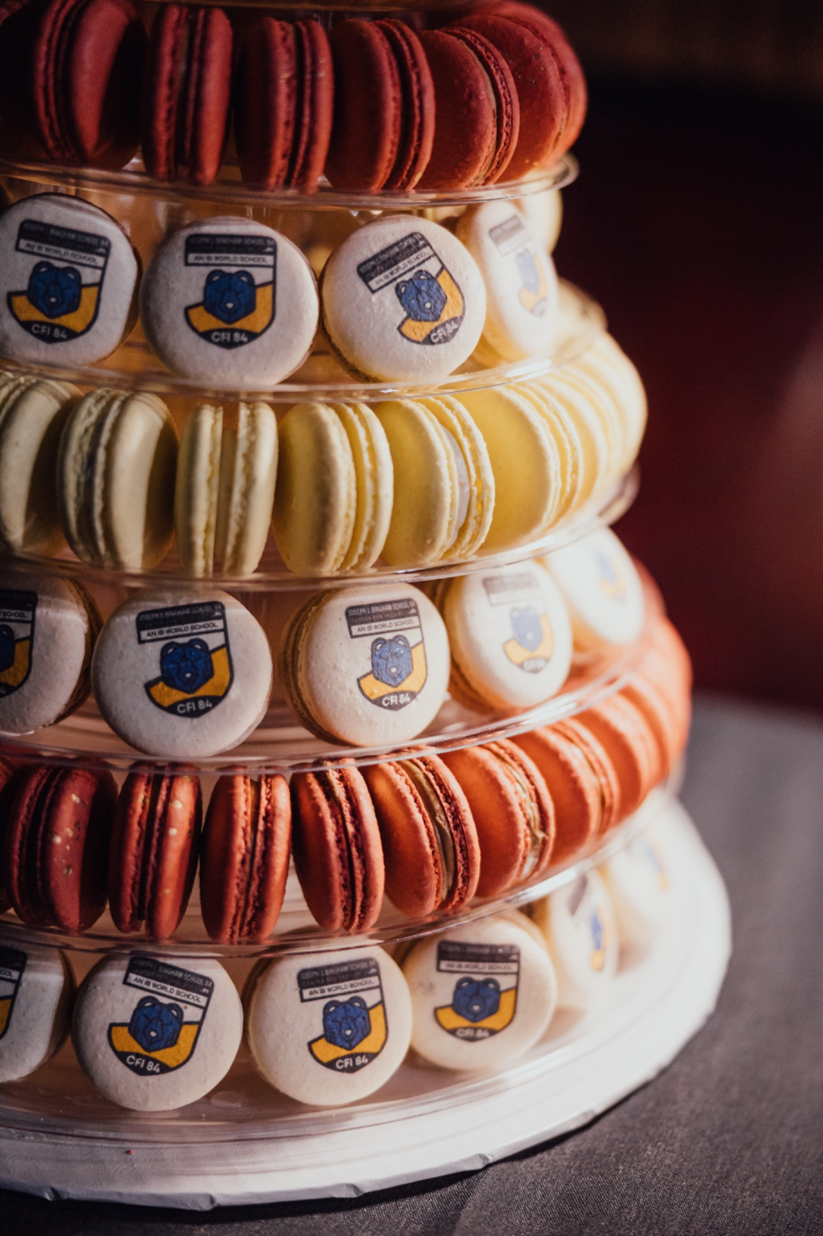
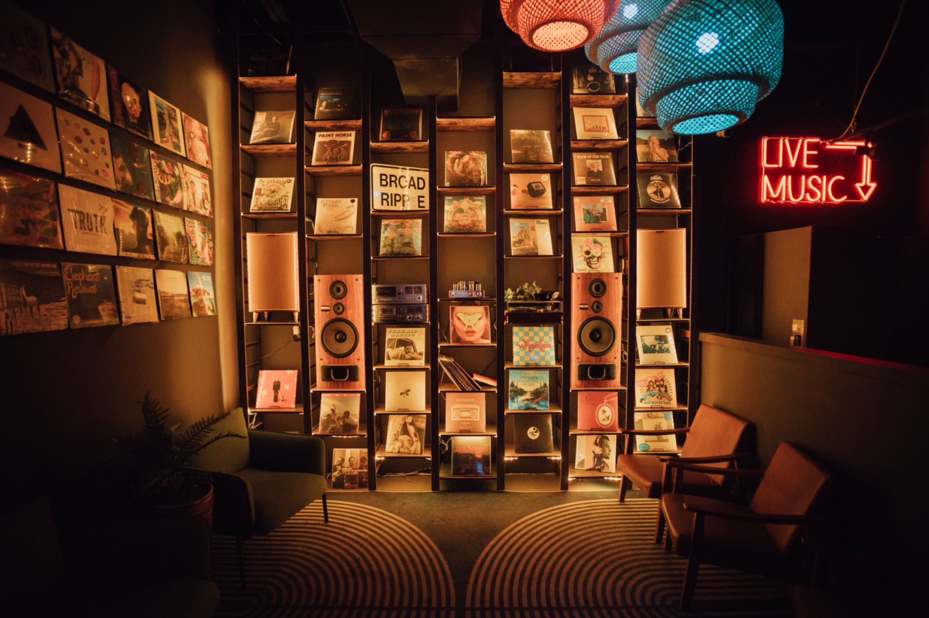
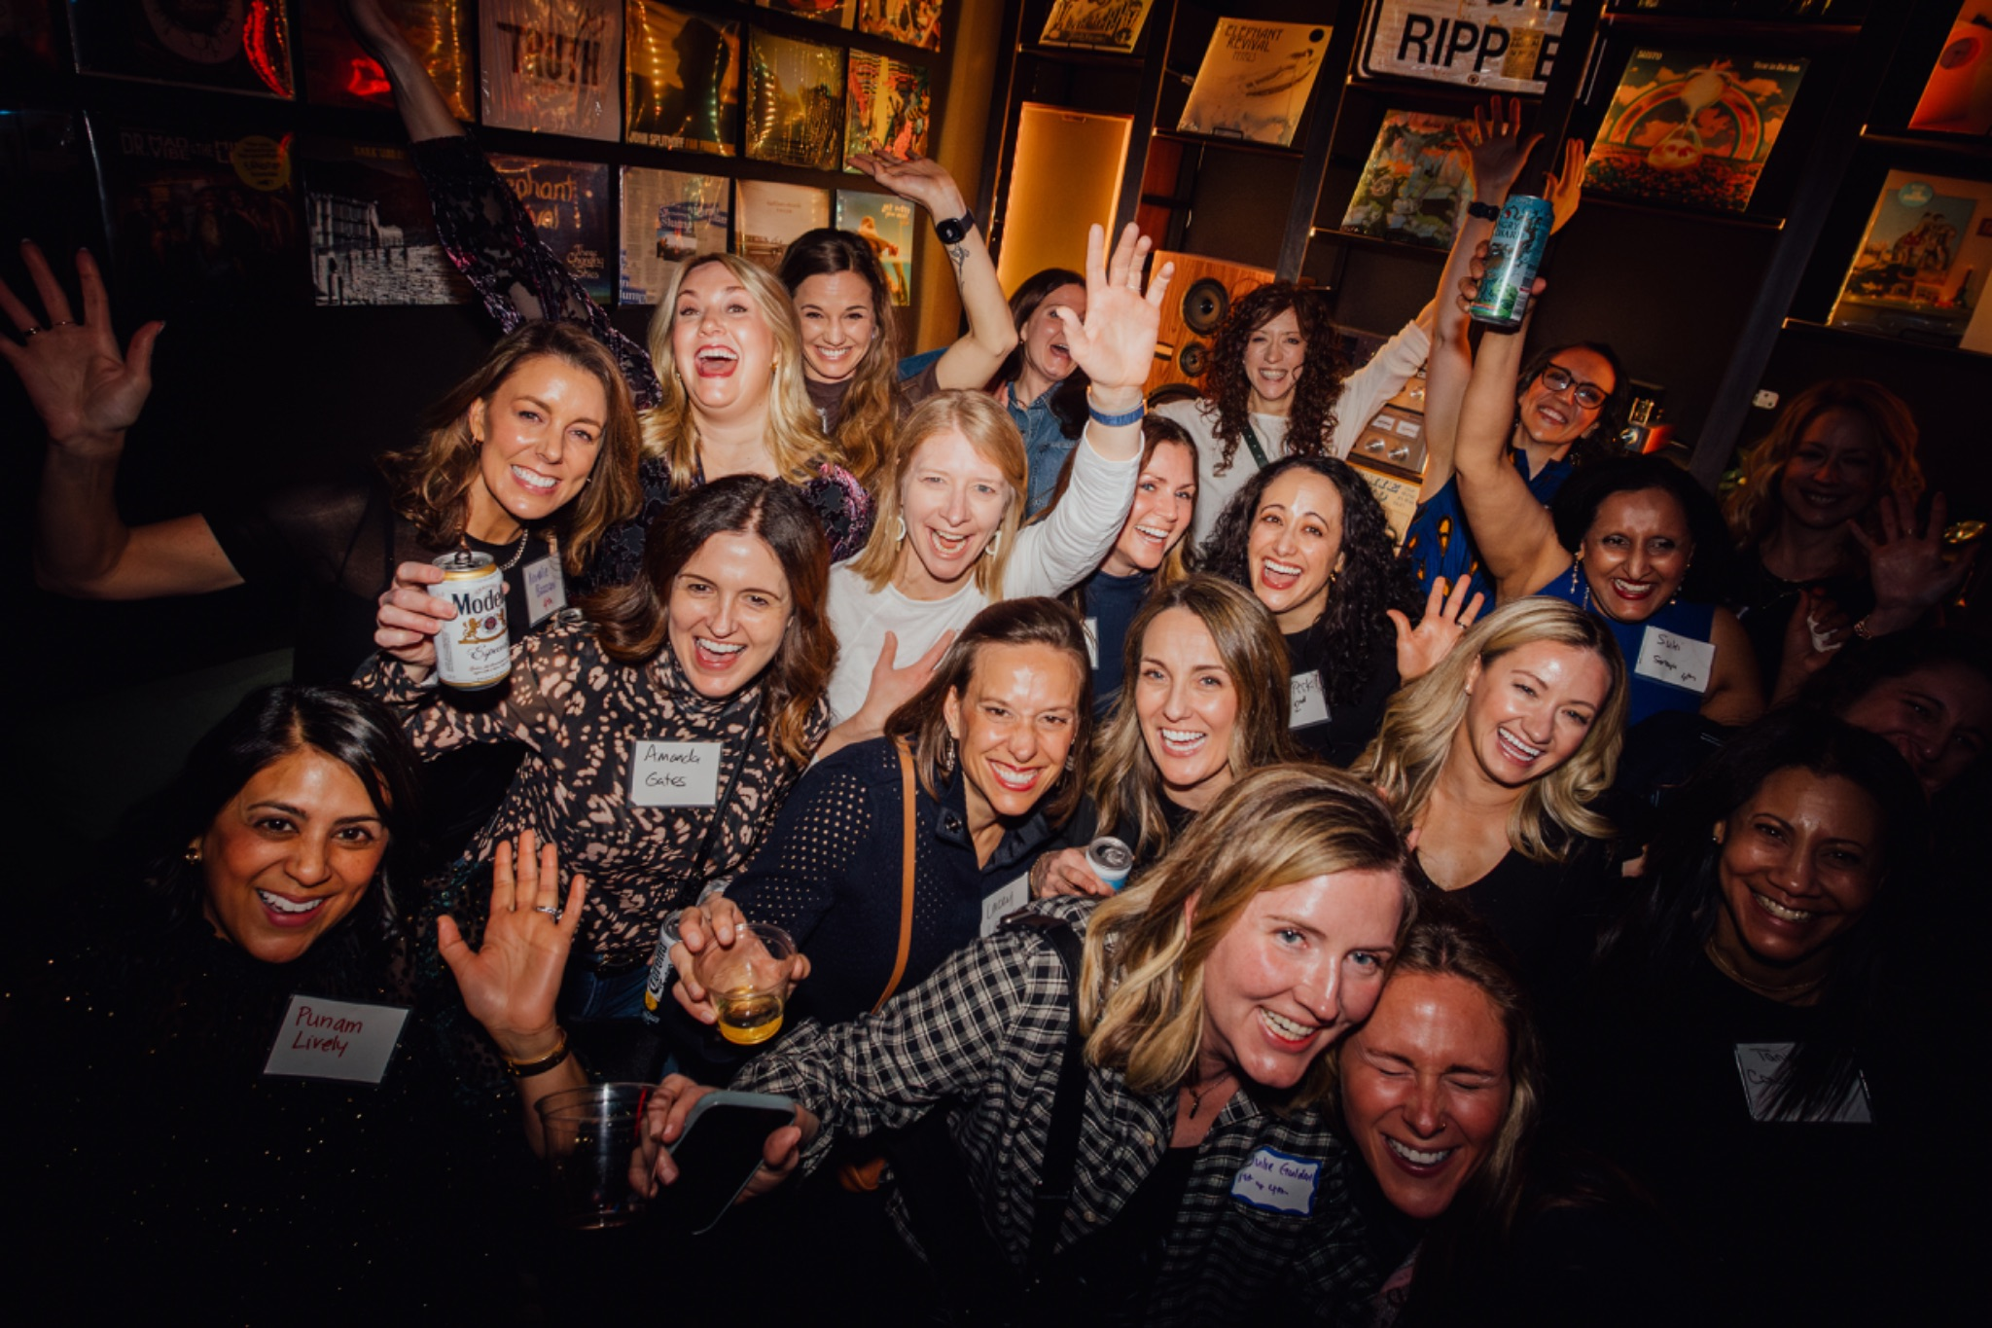
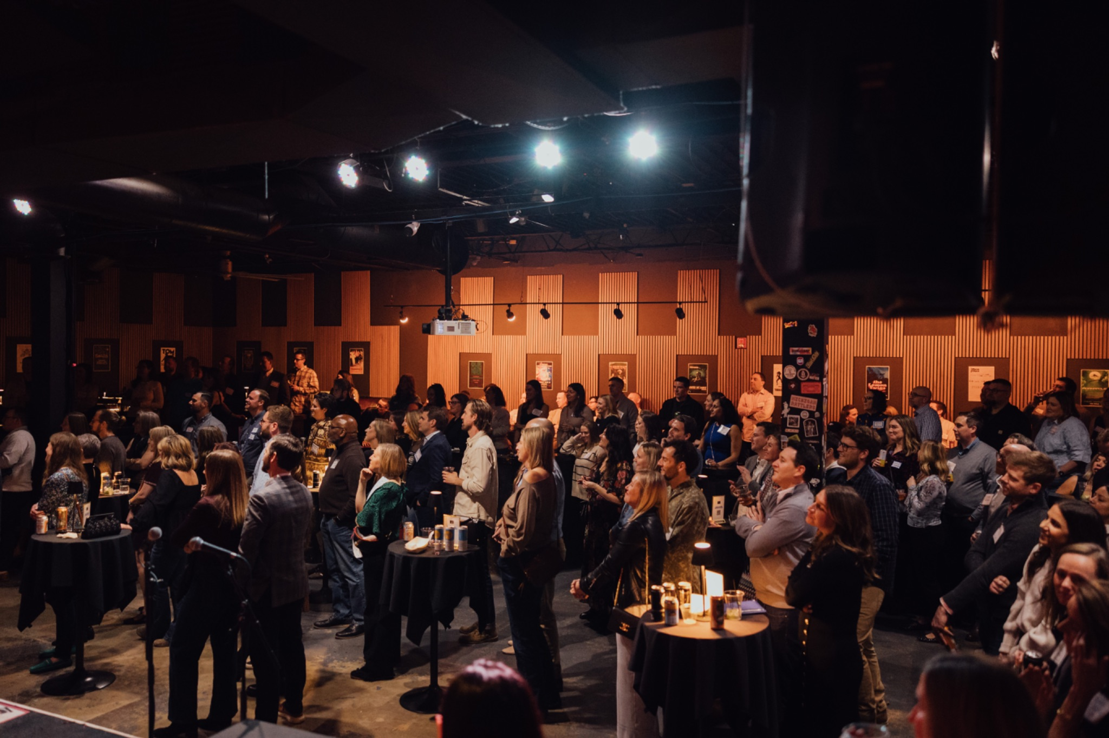
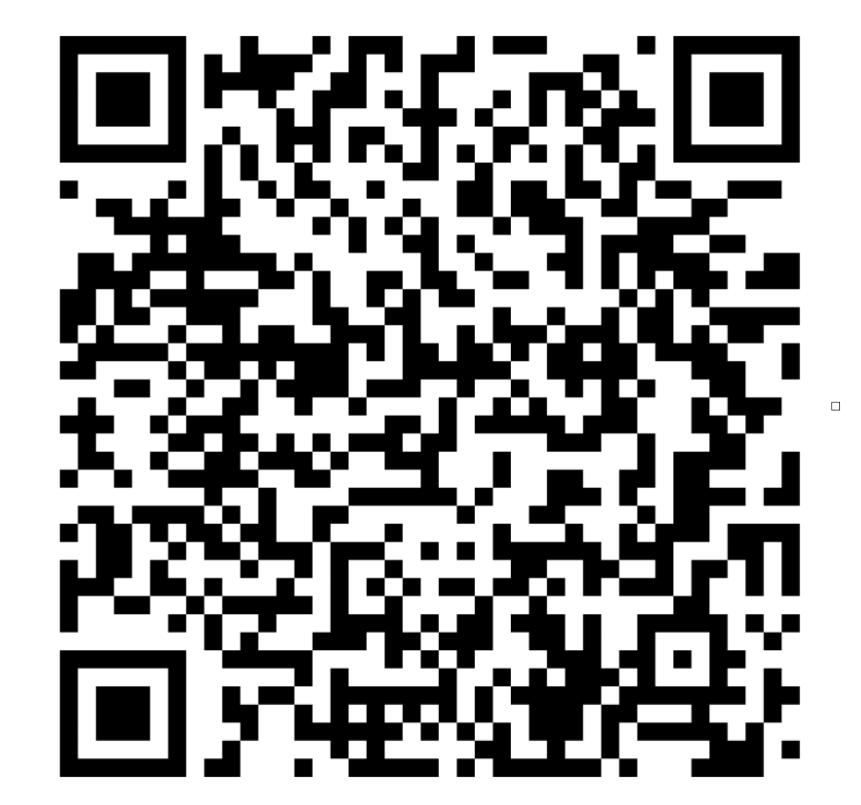
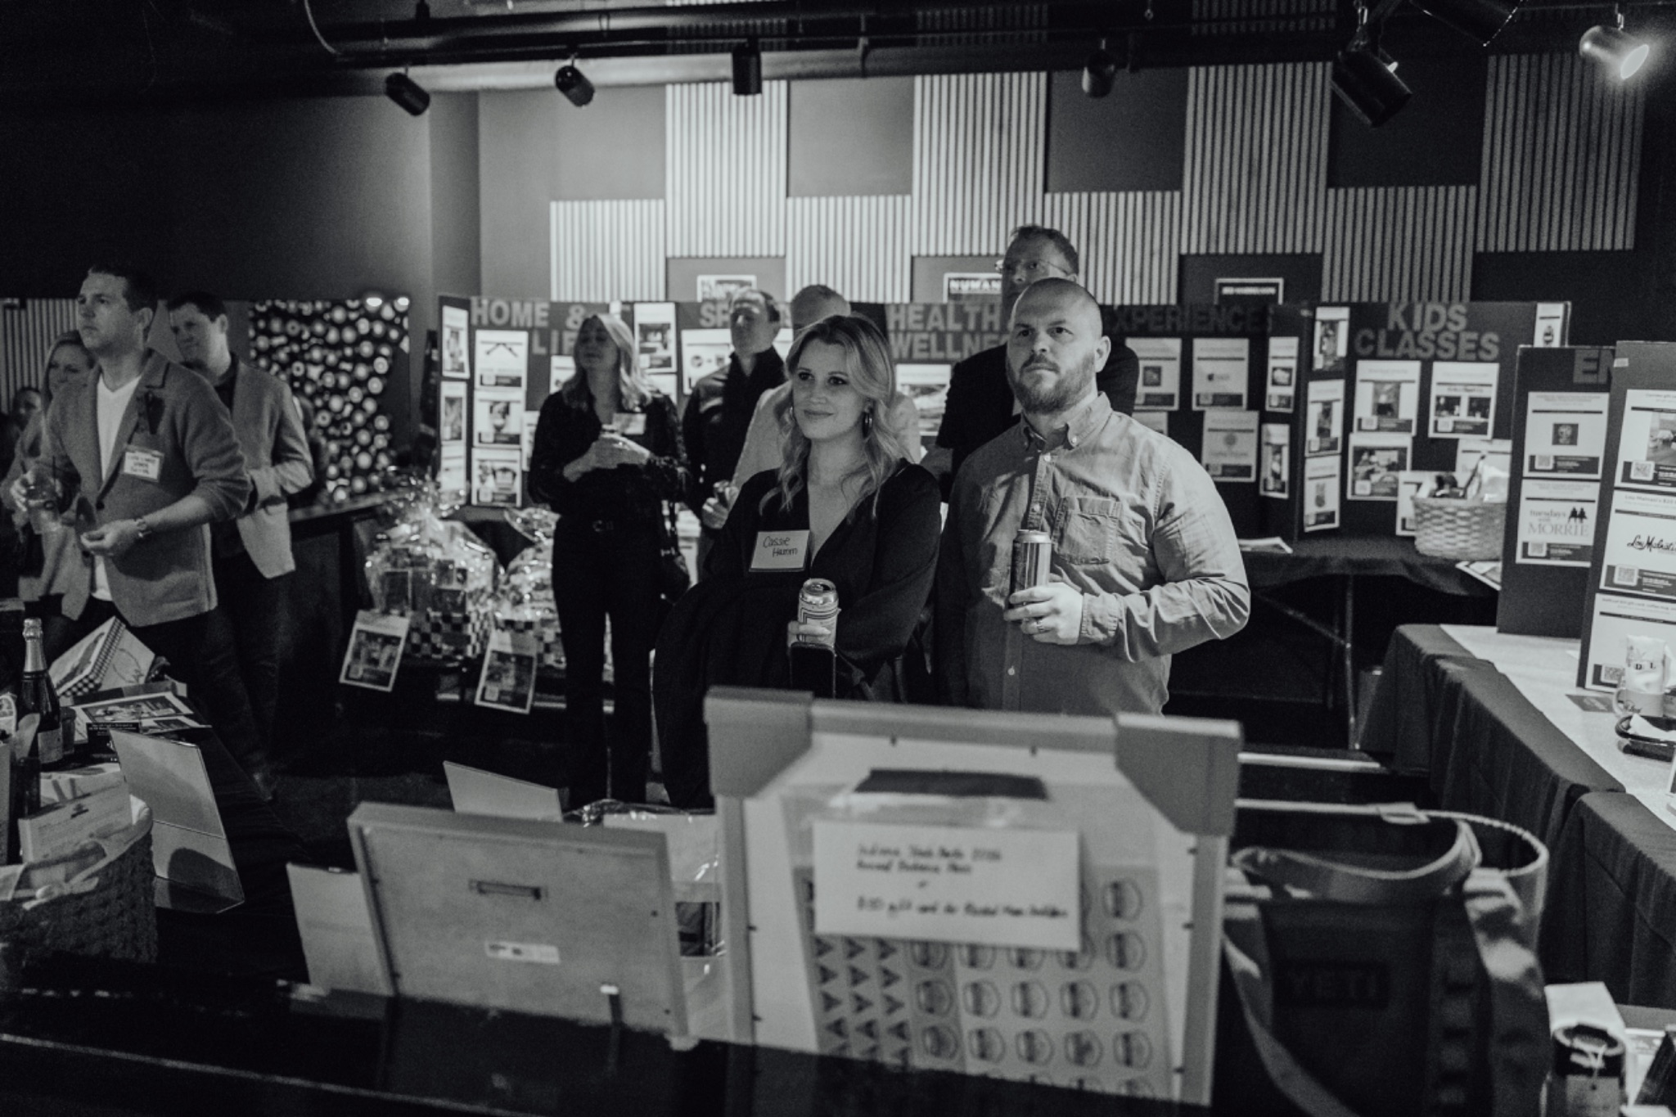
Ultimate Party 2026
Notes:
Lindsay Dodyk
We have a lot of professional pictures that are available.
The link is in the Toddle after the event.

Slide 22
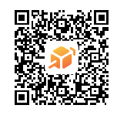
CFI 84 Fundraising
Parent Parties
  Still a few parent parties with tickets remaining!
    Off White Lotus Party
    BMX Biking
    Bourbon & Brews
    90’s Party
  Purchase tickets here ->

Slide 23
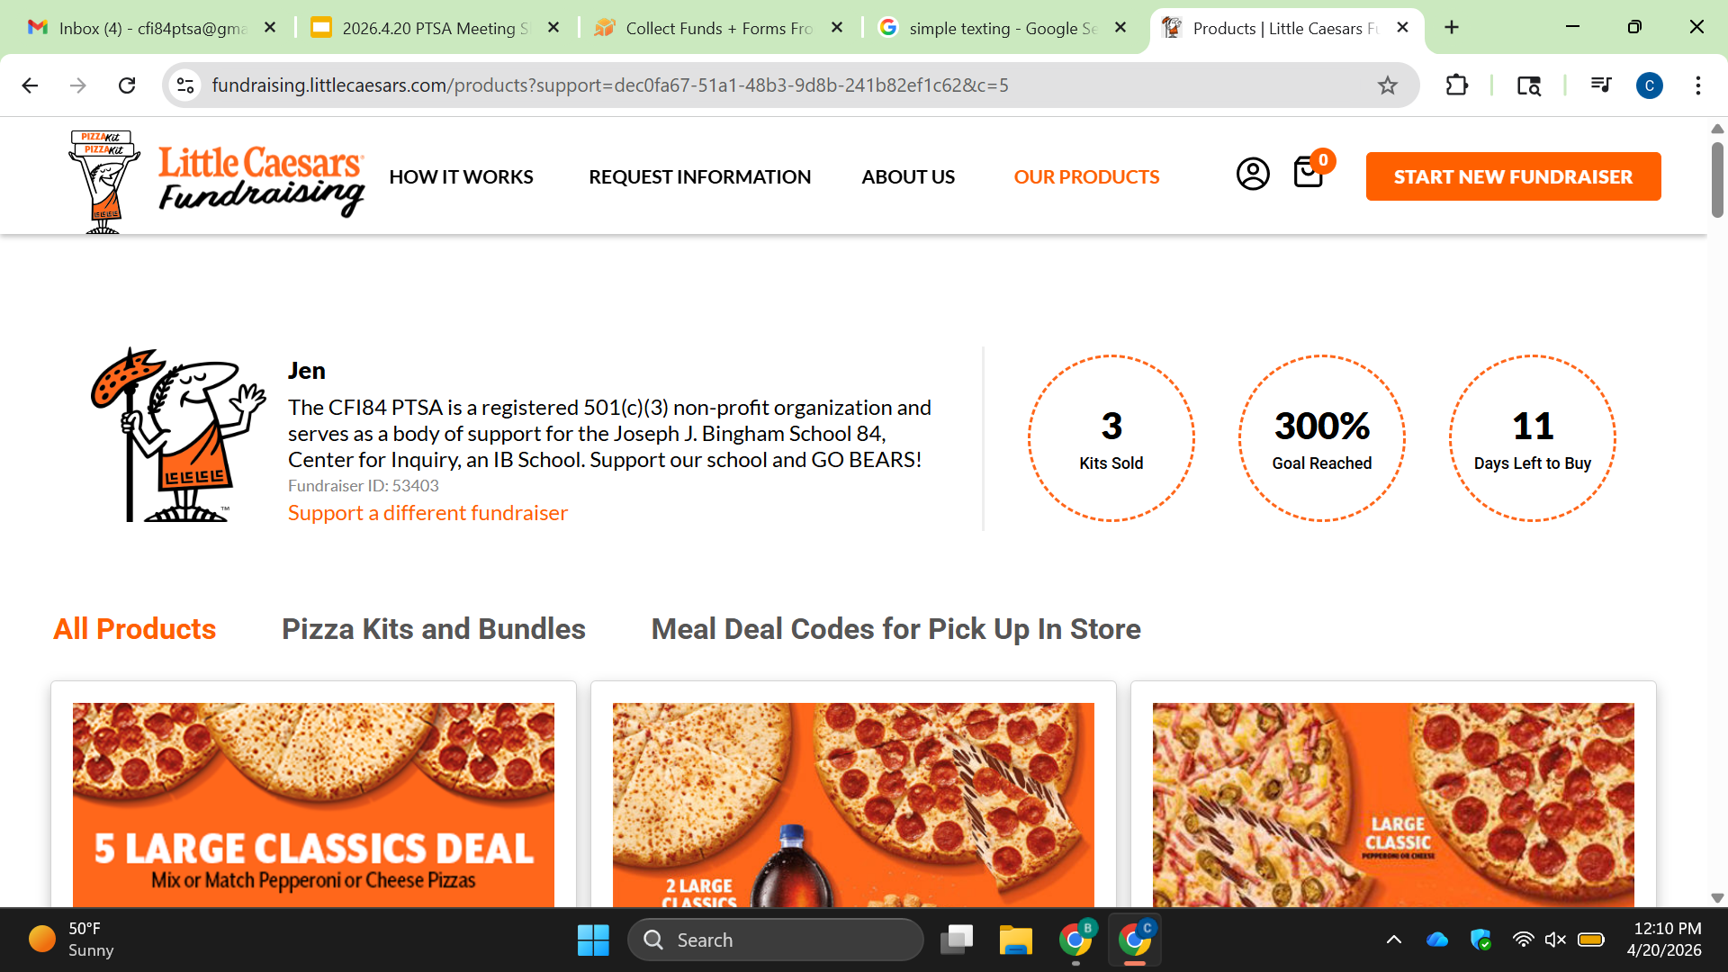
CFI 84 Dine to Donate - April
Still Ongoing!
Dine to Donate Opportunity is April is still open- Little Caesar Pizza Kits
Details can be found in Toddle and the next PTSA meeting.
*Remember all proceeds from Dine to Donate go directly to the school’s PTSA to support your child(s).*
Notes:
Details for purchasing Little Caesar pizza kits is in Toddle.

Slide 24
Events & Volunteer Opportunities
MANY upcoming opportunities to support our school and kids!
  Evening with the Arts- Friday April 24th
  Gardening Day - Friday May 1st
  Teacher Appreciation Week May 4th- 8th
  Bike to School Day: Wednesday May 6th
  PTSA Meeting: Monday May 11th
Please make sure you complete the new IPS Volunteer form and complete a
background check. The volunteer form/ background check needs to be done annually.
Interested in getting text updates? Text “CFI84” to 844-403-1950
VOLUNTEER
Notes:
Plenty of volunteer opportunities for May. Please use the QR Code to see volunteer opportunities.

Slide 25

Any Other Topics?
Discussion: Any new business to discuss?
If Raised, Motion To Discuss:
  *Kindly please say your name allowed for the minutes record, virtual attendees please vote via the chat/ comments section*
1st:
2nd:
Vote:
Scan to pay dues.
***Remember that only PTSA members may vote.***
Notes:
No new business to discuss.

Slide 26
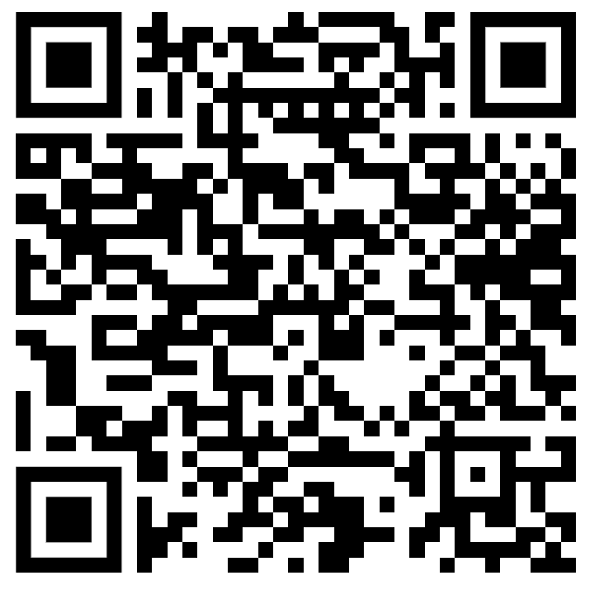
Motion to Adjourn
Discussion:
Motion To Approve:
  1st: Jes Daszkiewicz
  2nd: Paige Cardamon
  Vote: 7 Yes 0 No
Anonymous Feedback:
***Remember that only PTSA members may vote.***
Notes:
Yes: 7/7
No: 0/0

