Slide 1

Welcome to the CFI84 PTSA Meeting!
We’re glad you’re here!
We will begin promptly at 6:05pm.
If you’re joining on Microsoft Teams, please ensure your name is displayed. All attendees will be muted.
If you’re in-person, please introduce yourself to someone you do not know.
If you are unfamiliar with our Essential Agreements & Procedural Norms, please review them now via the link in the chat.
Notes:
Meeting called to order at 6:05pm.
In person attendees: Jenn Thiebert, Ashley Reff, Lindsey Dodyk, Stephanie Kime,
Zoom/Online attendees: Julie Gulden, Pam Bloss, Jess D, Paige Cardamon, Eric Van Veelan

Slide 2

To be a voting PTSA member, a reminder to please pay your PTSA dues.
Scan to pay dues.

Slide 3
CFI84 PTSA Meeting Agenda
Welcome
Essential Agreements & Procedural Norms
November 2025 Minutes Approval
Treasurer Report
Principal Miller’s Report
Committees & Coordinator Updates
Upcoming events & Volunteer opportunities
Motion to Adjourn

Slide 4
Essential Agreements & Procedural Norms
Your continued presence at this meeting affirms your commitment to adhere to these Agreements & Norms.
Essential Agreements Mapped To… | Procedural Norms
Transparency & Responsiveness: We want to be transparent in our norms and work, and responsive to all questions and comments. | Minutes will be taken in line with nonprofit norms and shared in a timely manner with the entire school community. An anonymous feedback survey will be offered after every meeting. Questions not answered in the meeting and placed in the Chat, or sent in the survey, will be responded to in a timely manner. Questions that address topics over which we have no decision-making power or control will be directed to the appropriate parties.
Trustworthiness: We want our meetings to be a safe space where everyone feels free to share. | Voting will be anonymous. We’ll use Microsoft Teams while virtual. Comments made by someone other than yourself may not be used outside this space. Comments and questions may only include your own voice.
Inclusivity: We want to be an organization that is designed with the inclusion of all people in mind. We shall do our best to break down all barriers to inclusion. | When presenting or sharing, speak as if your audience is completely new to the topic at hand. We have new parents and staff join our meetings all the time. Committees will remain open to new members.
Respect: We want to be respectful of ideas that are shared and the people who share them. Disagreement is okay, but we can disagree while adhering to the agreements and norms we have established as a group. | Name-calling, bullying and harassment will not be tolerated at Board or Committee meetings. A reminder to our commitment to adhere to these norms will be given. If the behavior continues, the offending individual may be muted and/or removed from the current and future meetings.
Commitment to the Work: We want our Board and Committee meetings to be efficient and effective. | We will reaffirm our adherence to these Agreements & Norms at the beginning of every meeting. We will begin and end on time. Those who join late will be admitted and private messaged the Agreements & Norms. If you choose to stay, you are agreeing to adhere to them. The CFI84 PTSA, and its committees/coordinators, have specific scopes of work. All officers, chairs, coordinators, members and volunteers who choose to engage in the work agree to support its implementation. Anyone working against the work may be removed or barred from meetings, emails, etc.

Slide 5
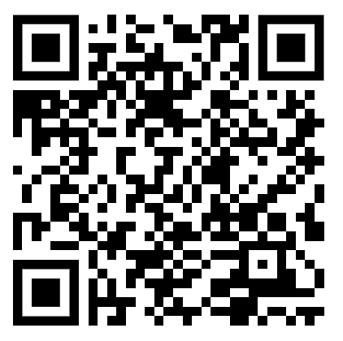
October 20, 2025 Minutes Approval
Discussion: (to review go to https://www.cfi84ptsa.org/)
Motion To Approve:
  Kindly please say your name allowed for the minutes record, virtual attendees please vote via the chat and linked forms*
Scan to pay dues.
  1st: Stephanie Kime
  2nd: Jen Theibert
  Vote: Yes 4/4 in person, 3/3 online; No: 0/0
***Remember that only PTSA members may vote.***
Notes:
Yes: 7/7 (4/4 in person, 3/3 online)
No: 0/0

Slide 6
Treasurer Report
New income:
  $1,036 from Crew Car Wash
  $102 from Kroger
Expenses: No, unbudgeted/unplanned expenses. Saving $160 year by no longer paying for Zooms (using Teams instead)
Notes:
Crew Car Wash was October Dine to Donate. Kroger is via the Kroger card. For expenses, we stopped our Zoom membership and refunded us $160. We are trying to reduce administrative costs each year.

Slide 7
Treasurer Report
Motion to Approve
Discussion:
Motion To Approve:
  1st: Lindsey Dodyk
  2nd: Jen Theibert
  Vote: Yes: 4/4 in person, 3/3 online; No: 0/0
***Remember that only PTSA members may vote.***
Notes:
Yes: 7/7 (4/4 in person, 3/3 online)
No: 0/0

Slide 8
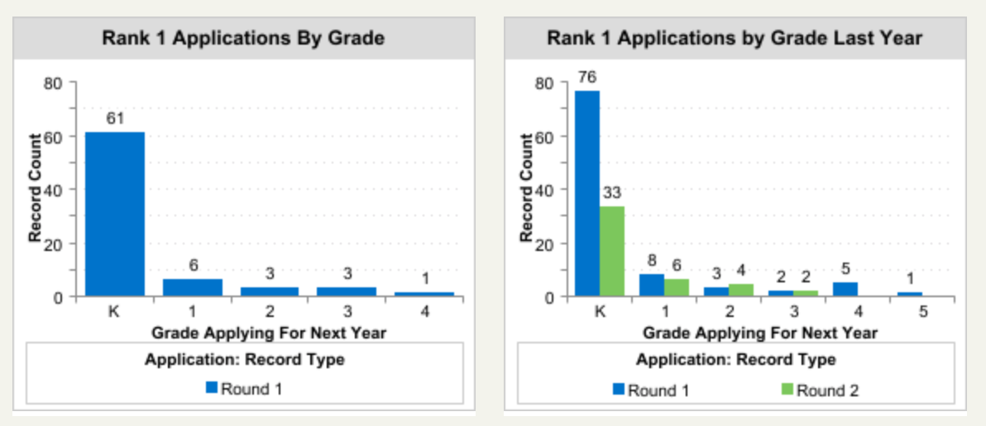
Principal Report
Notes:
Kathleen Miller presenting
This is the most recent lottery data that we have. We are on track for Round 1. Round 1 doesn’t close until around January 24 so these numbers are typical. We had packed Friday tours. Mostly Kindergarten families on the Friday tours. Things are looking good in terms of enrollment.
Jackie V: are we still looking at 2-3 kindergarten classes?
Principal Miller: we are looking at 2 for next fall. The reason we would do 2 is due to staff sustainability and being mindful of enrollment and what we can provided. It doesn’t mean we will never be back at three. It doesn’t make sense to do every other year because that is hard on teachers (they work very hard on curriculum). It also comes down to space - we don’t have a ton of extra classrooms, which would mean that one of the arts would have to be put on a cart. We would like to put some of our life skills kids in a bigger classroom (they are in a smaller than normal classroom). This is not official, but it is what we will be requesting.
Stephanie Kime: do you mean keeping three 1st and 2nd graders or it moves with them?
Principal Miller: it will move with them. Next year we will have 3 second and 3 third grades. We will keep the same number of classes with those grade levels. We will not need 3 first grade classes next year.

Slide 9
CFI 84 Partnering with Boulevard Place Food Pantry
Collecting items for families in need
See link for Immediate needs (also in Toddle):
Supporting our surrounding community.pdf - Google Drive
Drop off items in bin in front lobby of school
We’ve collected 769 items so far with a goal to get to 1,000!
Notes:
Meg Horn presenting
We are partnering with BFP. Several parents reached out when it seemed like SNAP benefits were not going to continue. Schools are the places that take care of families, and we partnered with BFP as they were in need of a lot of things (their donations were down). We are going to continue to do this until there is no longer a need. Goal is to get to 1,000 items. Hopefully we are going to make it before winter break. We were over 800 as of last Friday. We are created our free library to a free pantry. We could use more people to help make a drop. Email Meg Horn or Pam Bloss for that.

Slide 10
Committees & Coordinators
Committees | 2025-2026
Gardening & Outdoor Spaces | Paige Cardamon & Kate Leising
Hospitality & Teacher Appreciation | Lindsay Shaw & Ashley Reiff
Fundraising | Lindsay Dodyk, Stephanie Kime, Jes Daszkiewicz, Lisa Noe, Stefanie Kempfer Collier
Book Fair | Punam Lively & Julie Gulden
New Family & Community Support | Abigail Black & Chelsea Carpenter
Coordinators | 2025-2026
Volunteer Coordinator | Valerie Brod
Movie Night | Julie Gulden, Melissa Warth Tanya Couvillion, Laura Ruhl
Chit Chat Coordinator | Melissa Truong Warth
Dine to Donate | Jen Colson- Estes
Grade Parent Coordinator | Katherine Castro
Spirit Wear | Tanya Couvillion
Parent Copy & Coffee | Jes Daszkiewicz

Slide 11


CFI 84 Fundraising
Save the Date Ultimate Parent Party/Main event
  February 28th, 2026 at Turntable 6:30pm - 11pm!
  Tickets will go on sale January 15th
Parent Parties
  Goal of 15-18 parties
  Confirmed list of parties by January 9th
  Ticket site launches week of January 15th
Silent Auction - HELP NEEDED!
  Grade level baskets
  Tickets, vacation rentals, experiences
  Lessons, skills packages, wellness packages
S I L E N T A U C T I O N
Notes:
Lindsey Dodyk presenting
Date is February 28 at Turntable. We going to do a visit this week with committee members. Tickets will go on sale on January 15. We are trying to simplify this year. Lisa, Stephanie, and Kayla are working on parent parties. We have 8-9 committed parties so far, but we definitely need more. They will still be reaching out but looking to have a confirmed list by January 9. What we really need the most help with is silent auction items. We are trying to tweak and analyze Jess D’s spreadsheet to see what the higher yielding items because it may need to be smaller due to a smaller space. Someone to be in charge of the grade level baskets would be helpful, but the silent auction QR code is for donation and to get a lead for donations. Focus of silent auction is lessons/tickets/etc with less gift cards and things like that. We also need someone to lead the silent auction.

Slide 12
Hospitality & Teacher Appreciation
Stock the Staff Lounge:
The last restock was a huge hit! Thank you for everyone who contributed. We are looking to replenish snacks and drinks before the semester ends.
Items needed: Snacks, gluten-free snacks and drinks
Sign up via Sign-up Genius at CFI 84 Families: CFI 84 Rolling Volunteers/Donations (link also in Toddle)
Notes:
Ashley Reiff presenting
We are doing another round of stock the staff lounge. Donations are due this week. Opportunities are out on Toddle and Signup Genius. There are only a few spots left.

Slide 13


Holiday Gifts for Teachers & Staff
At CFI 84 we collect holiday gift contributions in aggregate and then divide it equitably across teachers & staff
You are welcome to gift your teacher something individually if you prefer
Notes:
We are doing a collection that will go to all staff and teachers. It is not mandatory to contribute. If you also want to give something separately, that is also okay. This link is out on Toddle. Cutoff date is Friday

Slide 14
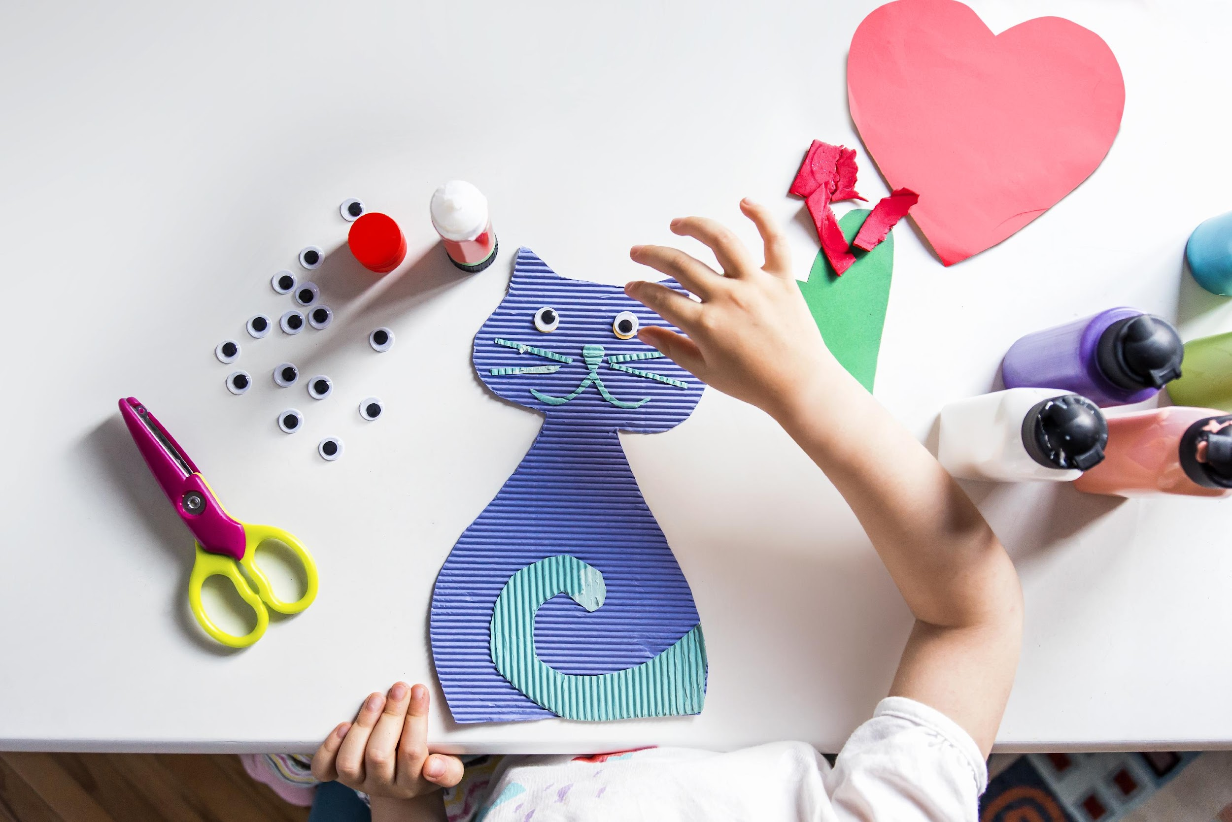
Grade Parent Coordinator
End of Semester Celebrations are coming!
Details will be sent out soon from respective grade parent coordinators for your child(s) grade celebration and any opportunities to get involved. Be on the lookout for an email and/or social media communications giving more specifics.
Coordinator: Katherine Castro (katherine.castro@gmail.com)
Notes:
You should receive something if you haven’t already. Email questions to PTSA and Katherine Castro.

Slide 15

Chit Chat Book
Chit Chat Book is Live!!!
School Directory, opted in by parents/guardians
Hard copies may be purchased for $5 and will be ready in the coming weeks
You can order via cheddar up at: https://my.cheddarup.com/c/chit-chat-book-copy/items
Notes:
It’s live! You can purchase a hard copy at the link, and there is a link in Toddle under School Resources. Last year’s ChitChat book is also out on Toddle.

Slide 16
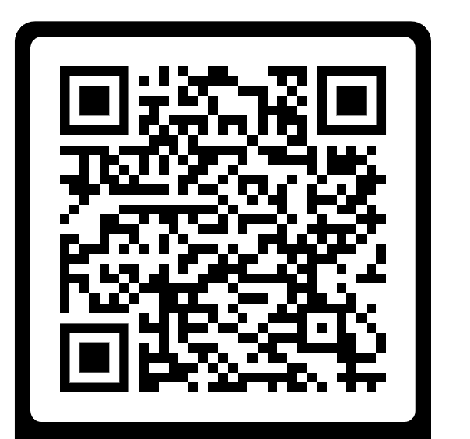
Events & Volunteer opportunities
MANY upcoming opportunities to support our school and kids!
  Friday December 12th – Parent Coffee & Copy
  December Classroom Winter Parties - more from grade parents coming soon
  December Teacher / Staff Support Fund Callout
Please make sure you complete the new IPS Volunteer form.
You need to do this annually.
Interested in getting text updates? Text “CFI84” to 844-403-1950
VOLUNTEER
Notes:
A lot of things happening in December. You must have your volunteer form filled out if you want to volunteer at school. We are also looking for a new treasurer. It’s not difficult but it is important. You do not have to have a financial background. Please see us if you are interested.

Slide 17

Any Other Topics?
Discussion: Any new business to discuss that may require decisions in January?
IF Raised, Motion To Discuss:
*Kindly please say your name allowed for the minutes record, virtual attendees please vote via the chat/ comments section*
  1st:
  2nd:
  Vote:
Scan to pay dues.
***Remember that only PTSA members may vote.***
Notes:
Ashley Reiff presenting
The Hospitality Committee is going to have a coffee/treat cart next week for the teachers. We will coordinate with Pam Bloss.

Slide 18
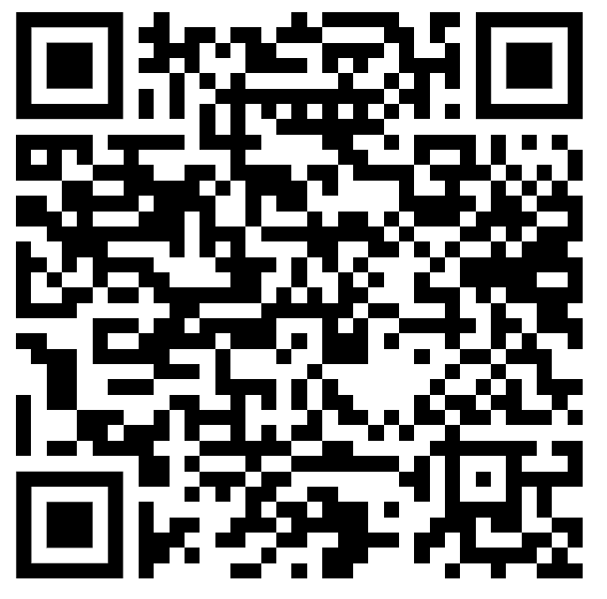
Motion to Adjourn
Discussion:
Motion To Approve:
  1st: Ashley Reiff
  2nd: Jen Thiebert
  Vote:Yes: 4/4 in person, 5/5 online; No: 0/0
Anonymous Feedback:
Scan to pay dues.
***Remember that only PTSA members may vote.***
Notes:
Yes: 9/9 (4/4 in person; 5/5 online)
No: 0/0

